Slide 1

A-Network
By UCSM_The_Owls

Slide 2
Introduction To A-Network
A-Network is a formally socialized student affair that runs on a Php Server.
Its main purpose is to improve the students’ life campus by mean of communication.
It provides a media where students can connect to each other.
Students shall share their experience, knowledge and feelings though the website.
Students can make friends with others and improve their skills by learning as a group.

Slide 3

Implementation Tools
A-network is implemented using:
Html
Css (Bootstrap)
JavaScript (JQuery)
Php (Laravel)
SQL
Source: http://digiguyzz.com/technology/programming-languages-developers/
Notes:
© Copyright Showeet.com – Free PowerPoint Templates

Slide 4
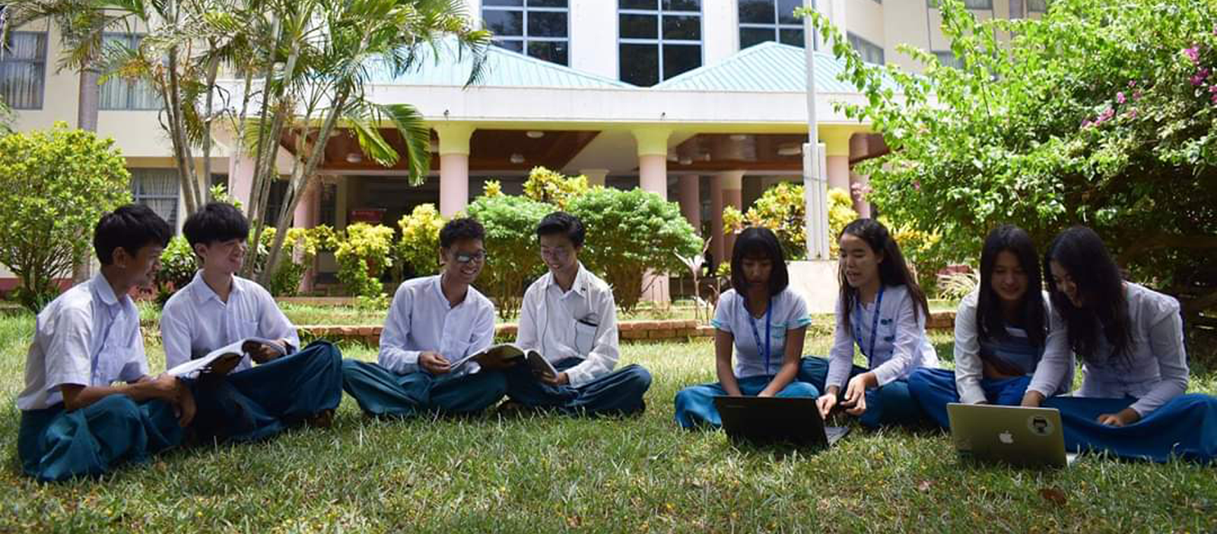
A Tour of A-Network
Visit and Feel it
Notes:
© Copyright Showeet.com – Free PowerPoint Templates

Slide 5
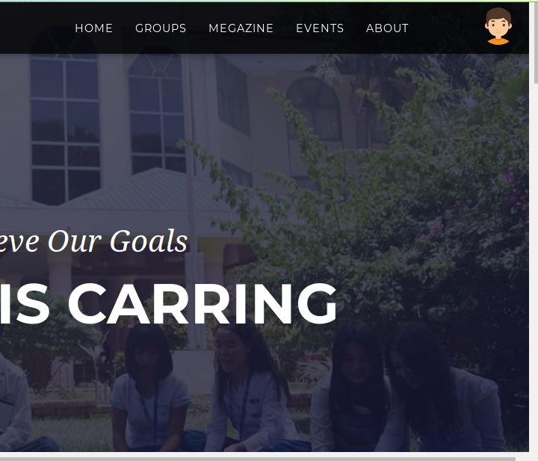
Homepage
As mentioned in Application Form, Home page has 3 sections:
Events
Learning Group
Magazine
Notes:
© Copyright Showeet.com – Free PowerPoint Templates

Slide 6
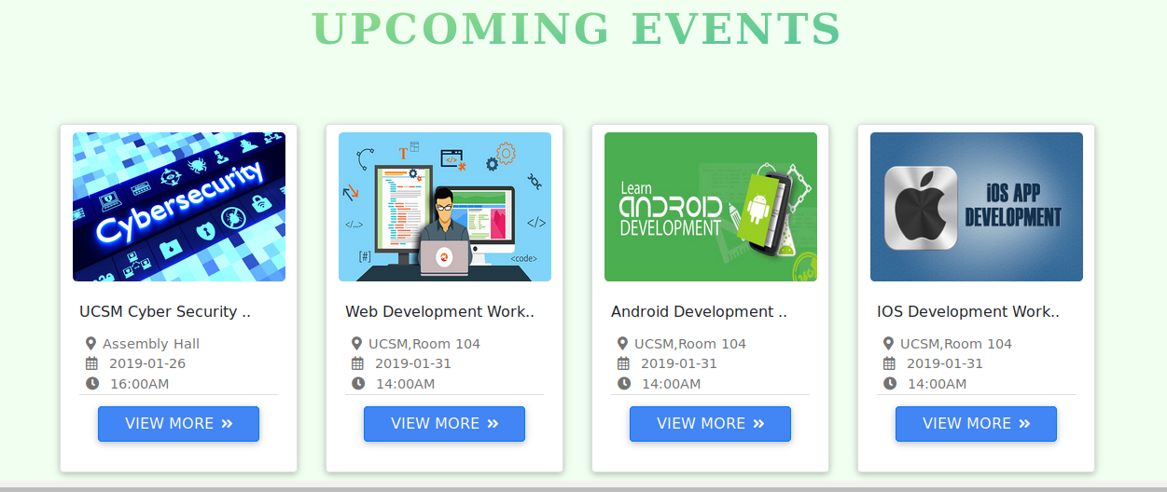
Events
In these section, not only members but also visitors will be able to know both the upcoming activities and finished activities in the University.
(We hope this feature may obtain students’ great interest and motivates them to visit the site frequently to view updated news)
Notes:
© Copyright Showeet.com – Free PowerPoint Templates

Slide 7
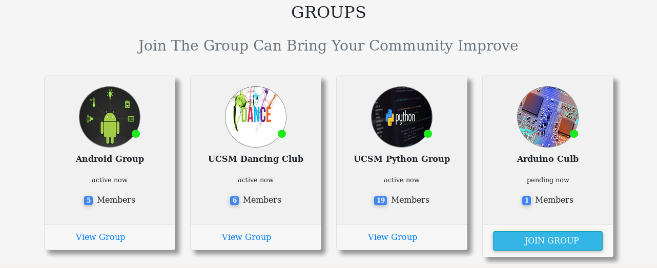
Learning Groups
This section is for students to able to find friends with his studies for both academic and for extracurricular activities.
(Only members can create new learning groups and join the existing group. The learning groups will become active only when it has at least five members. Until that, no features provided can be used.)
Notes:
© Copyright Showeet.com – Free PowerPoint Templates

Slide 8
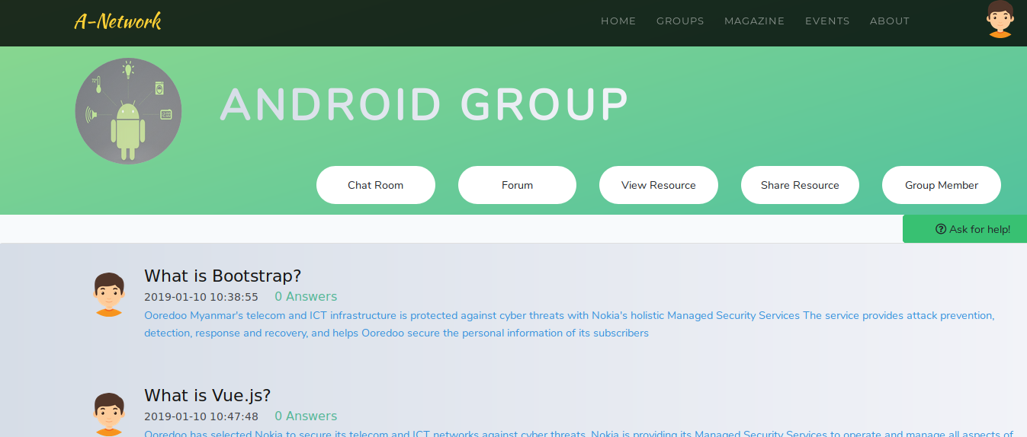
Learning Groups
There are three sections in each learning group.
File Sharing
Discussion Room
Ask For Help!(including forum)
Notes:
© Copyright Showeet.com – Free PowerPoint Templates

Slide 9
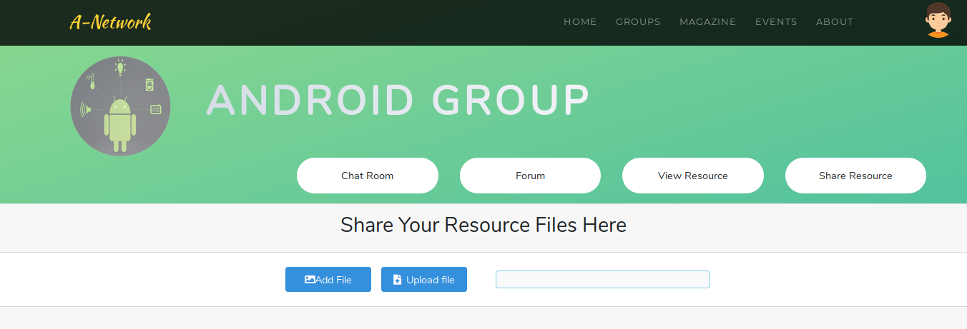
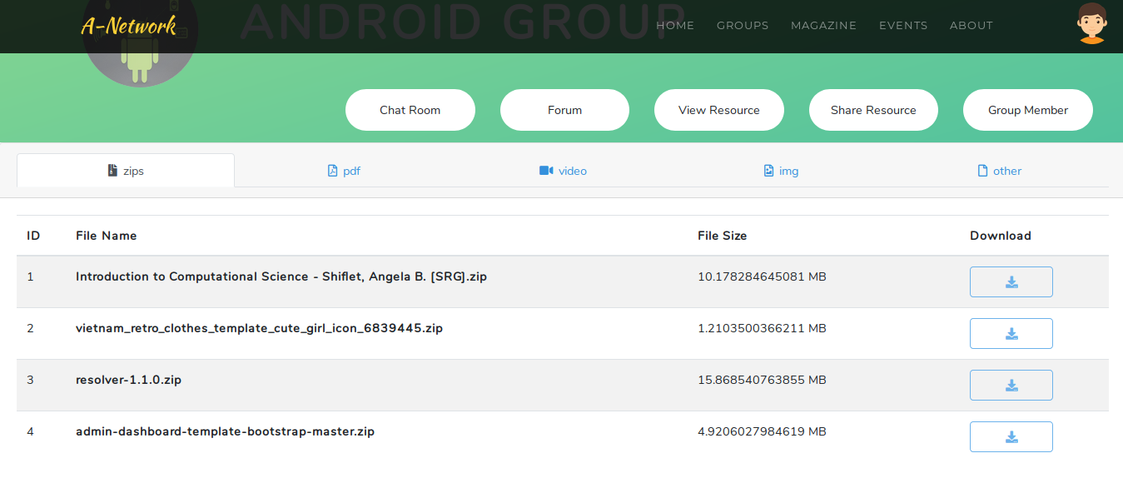
Learning Groups (File Sharing)
In file sharing section, the group member will be able to upload and download these kinds of files:
Notes:
© Copyright Showeet.com – Free PowerPoint Templates

Slide 10
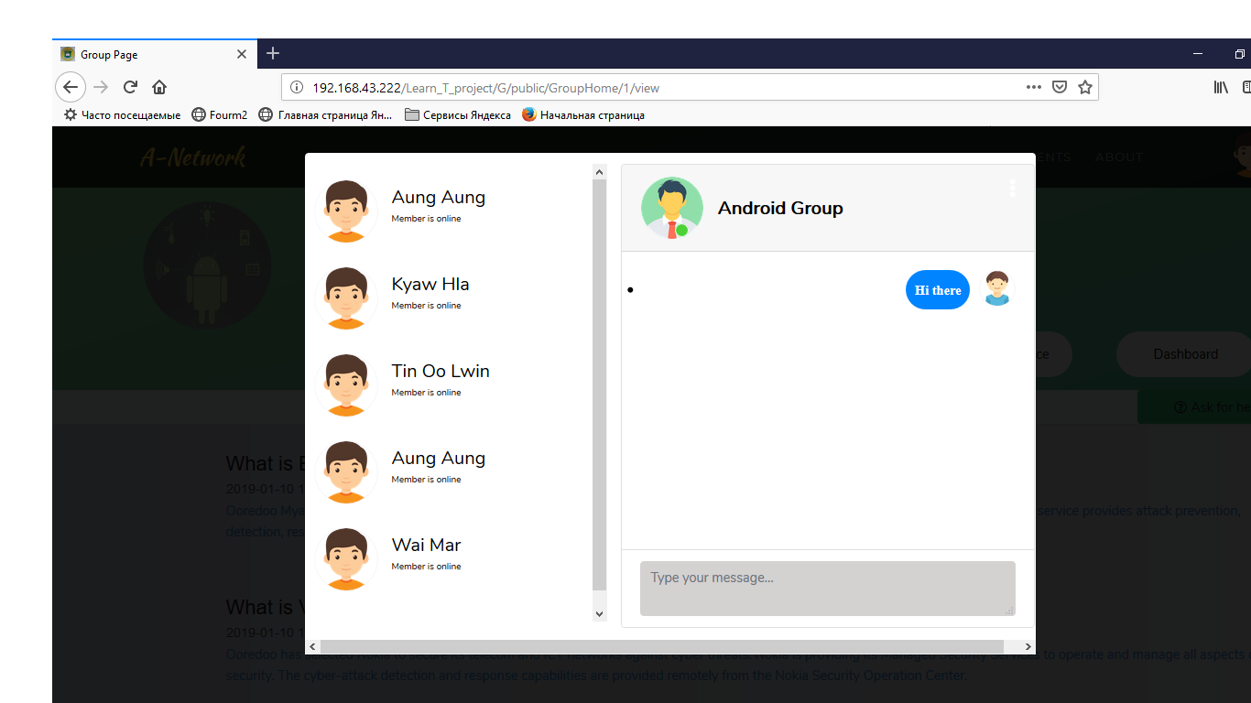
Learning Groups (Discussion room)
Discussion room is for the group members to become more familiar with each other. It may be about serious matter or just chit-chat.
Notes:
© Copyright Showeet.com – Free PowerPoint Templates

Slide 11
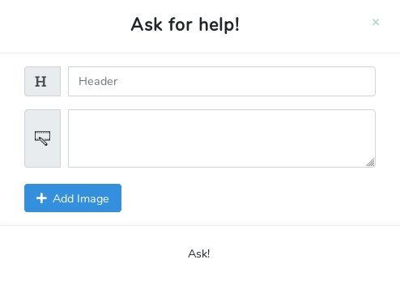
Learning Groups (Ask for help!)
This section, unlike discussion room, is designed only for serious matter. When a member is in trouble, other members will figure a way to help him with different ideas.
(Members should not ask non-sense questions in this section.)
Notes:
© Copyright Showeet.com – Free PowerPoint Templates

Slide 12
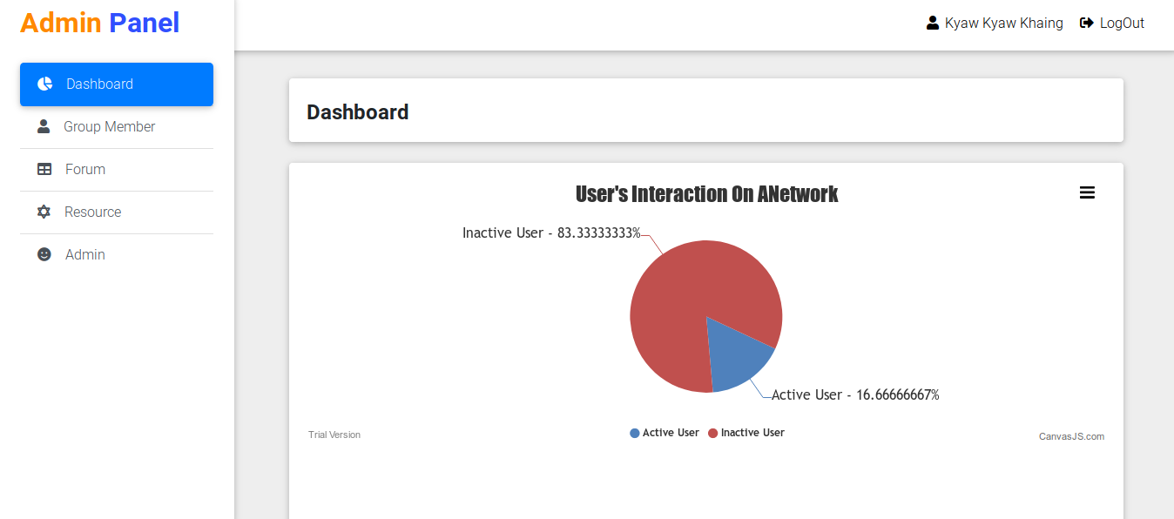
group Admin
There shall be at least an administrator for each group which is responsible for banning inappropriate resources, questions and answers. A group administrator shall be the first student who create the group and have authorize to add more administrators.
Notes:
© Copyright Showeet.com – Free PowerPoint Templates

Slide 13
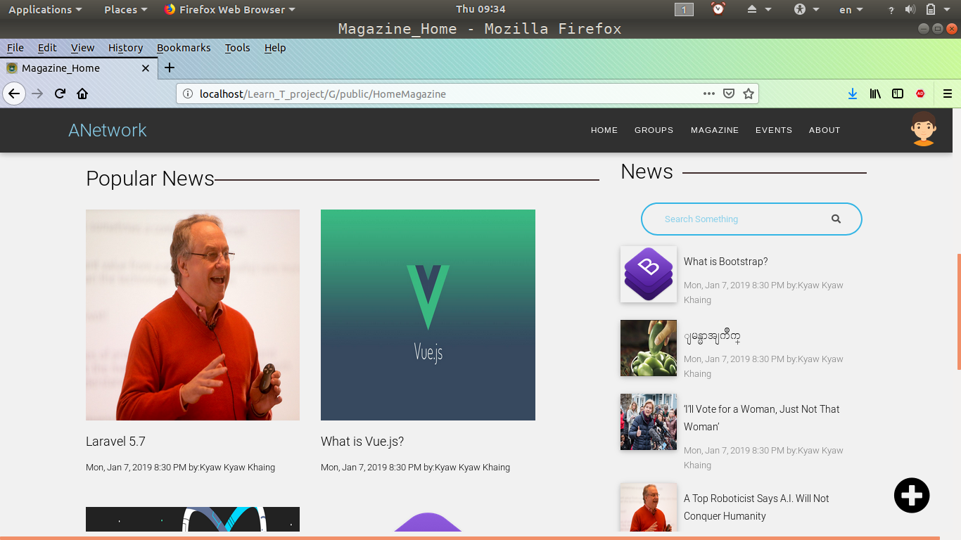
Magazine
It is a digital online magazine where students can apply their creativity ideas or share their knowledge, experience and feelings.
(The articles will refresh on a specific day every week. )
Notes:
© Copyright Showeet.com – Free PowerPoint Templates

Slide 14

Administration
Behind the scenes
Notes:
© Copyright Showeet.com – Free PowerPoint Templates

Slide 15
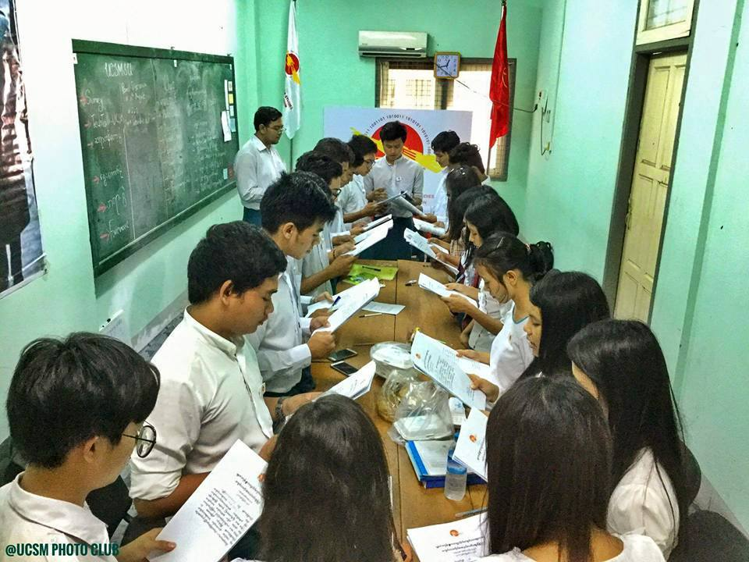
Assumption
We assume that an organization of students like Student Union will have control on the web application and form the administrator team to handled the website.
All students of the specific university will manage to have their id and password form the organization.
Notes:
© Copyright Showeet.com – Free PowerPoint Templates

Slide 16
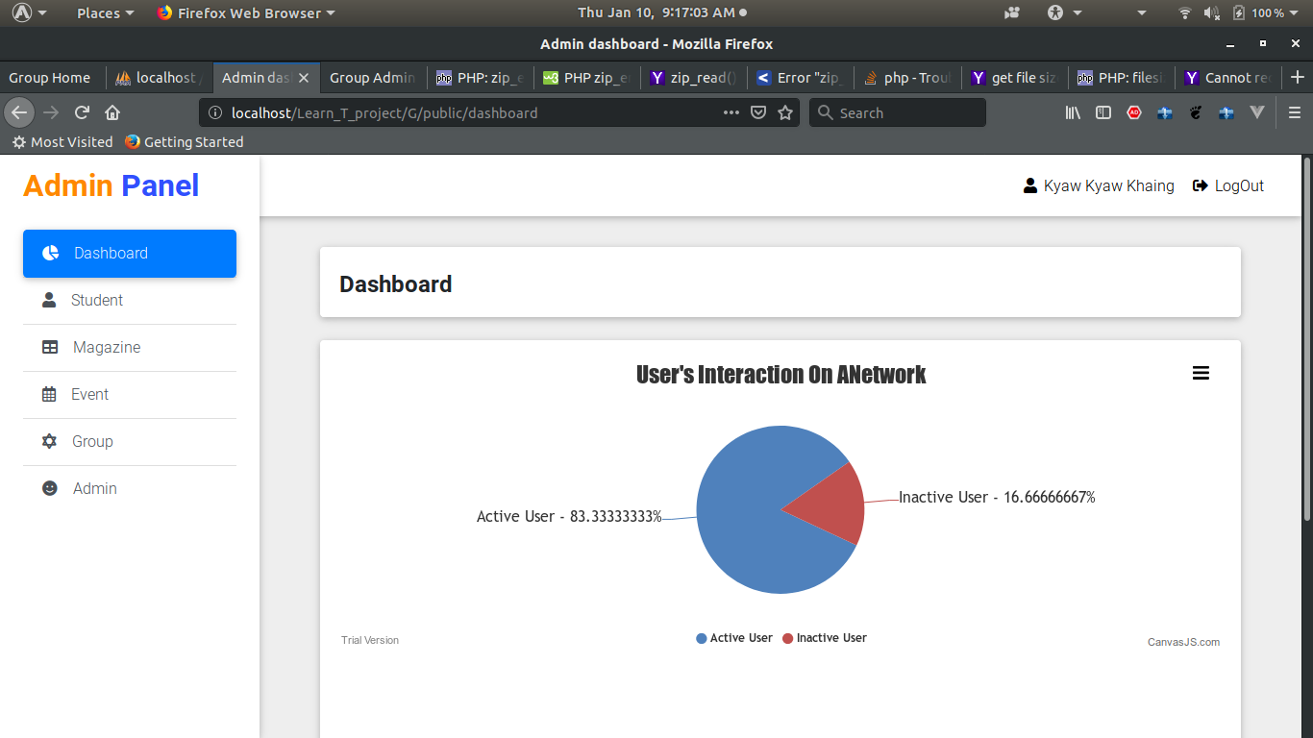
Admin panel
In the admin panel, there are five sections:
Student
Magazine
Event
Group
Admin
Notes:
© Copyright Showeet.com – Free PowerPoint Templates

Slide 17
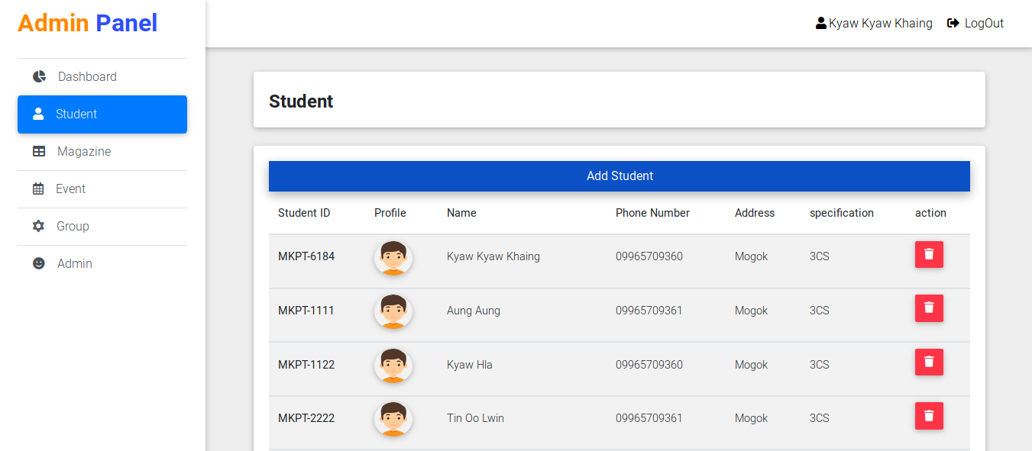
student section
In this section, admin shall manage the student members by registration and deleting students.
Notes:
© Copyright Showeet.com – Free PowerPoint Templates

Slide 18
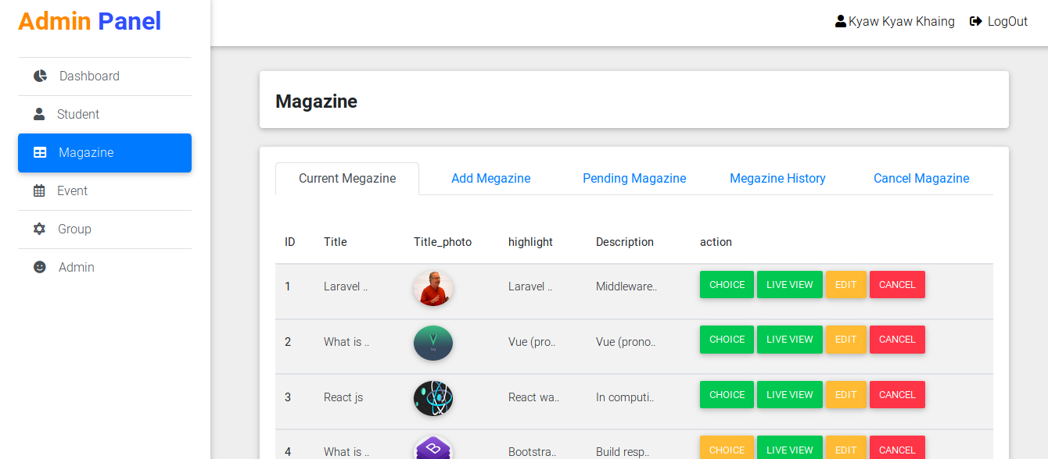
Magazine section
In this section , the admin shall receive the articles from the students and upload the magazine weekly .
(The admin shall choose three favorite articles as editor’s choice ones.)
Notes:
© Copyright Showeet.com – Free PowerPoint Templates

Slide 19
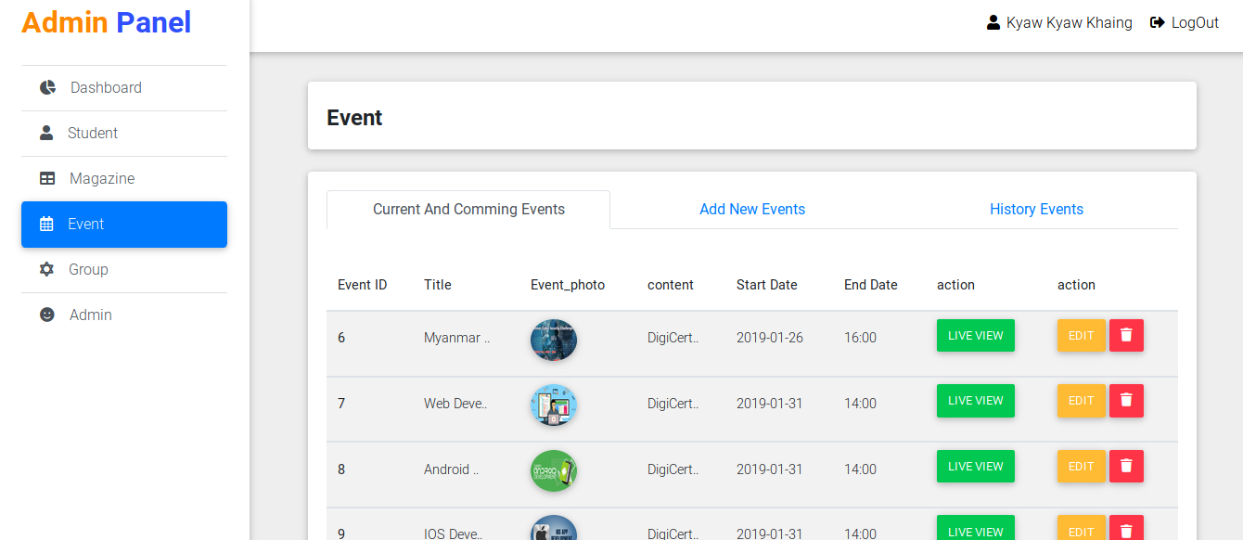
Event section
In this section, admin can
Create new event announcement
Edit the old ones
Or delete the undesired one.
Notes:
© Copyright Showeet.com – Free PowerPoint Templates

Slide 20
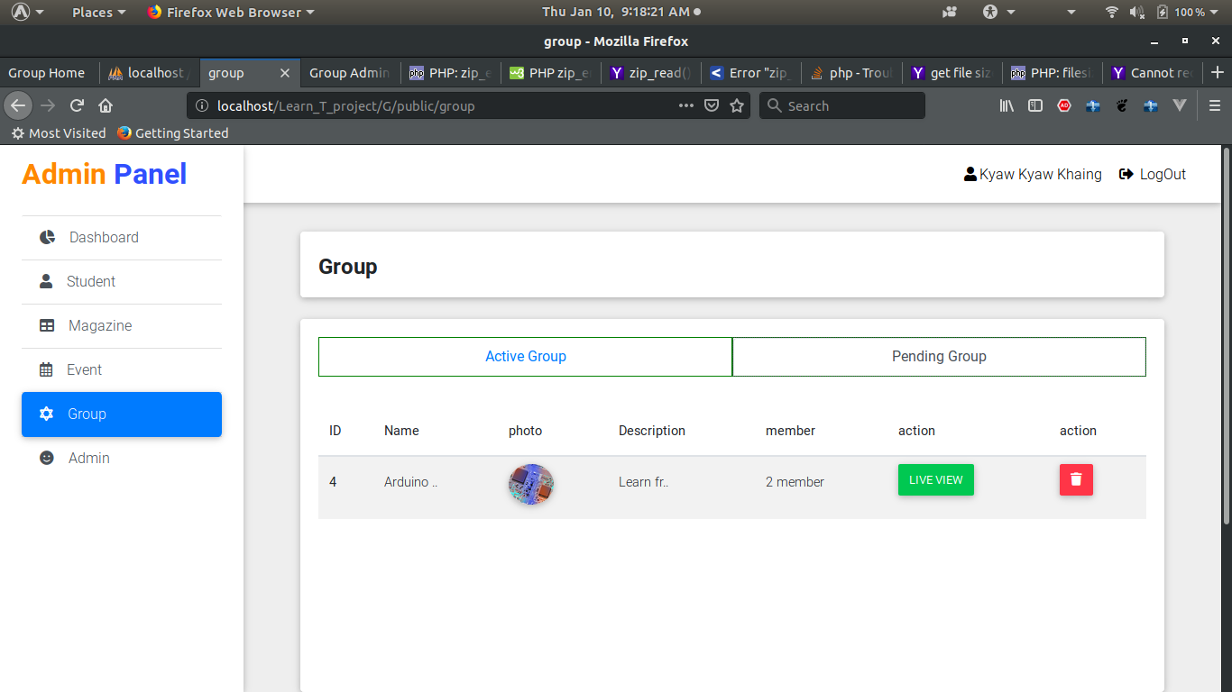
group section
In this section, the admin shall manage all groups.
Notes:
© Copyright Showeet.com – Free PowerPoint Templates

Slide 21
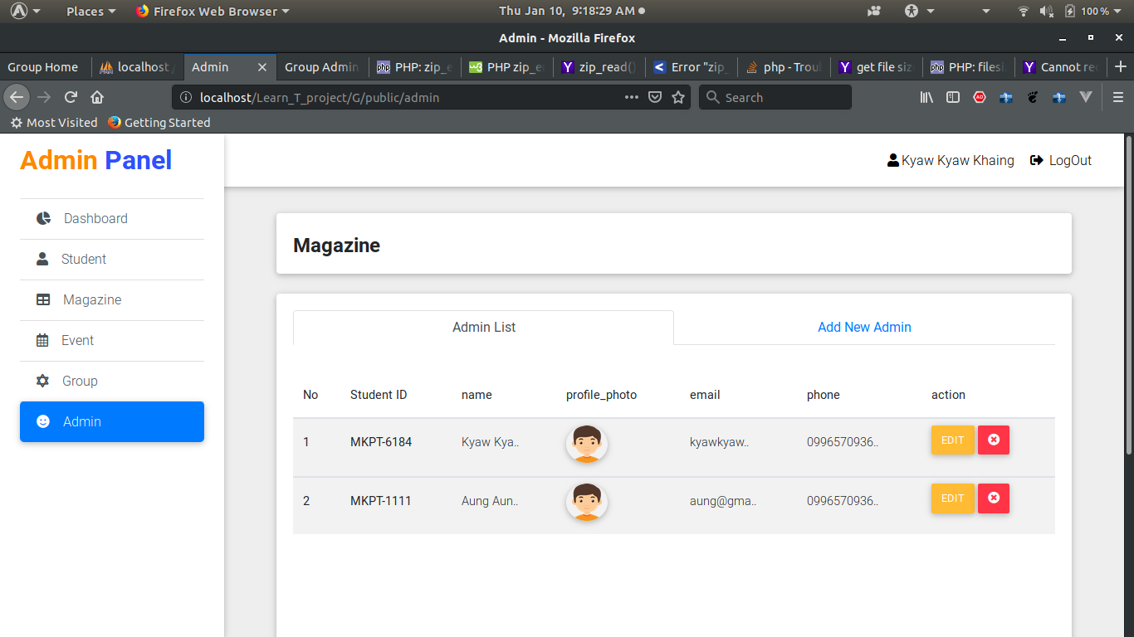
Admin section
In admin section, the existing admin can add more new administrators.
Notes:
© Copyright Showeet.com – Free PowerPoint Templates

Slide 22

Future Plan
We will we do
Notes:
© Copyright Showeet.com – Free PowerPoint Templates

Slide 23
The Future Plan
1. Buy a Domain ( For UCSM)
2. Make the improvements
After we have finished the project, we would like to hire an online server to host the website, negotiate with the Student Union in UCSM for both administration and budget, and allow every student in UCSM to use it. After that, we would like to collect feedback from the users, and would improve the website.
As the website is developed by only four people, weakness may still be found within the website. So, to be able to applied on the real world environment, we would like to invite more students to help us develop a better web communication between students and the next improvement may be a network for all universities in Myanmar.

Slide 24


